Slide 1
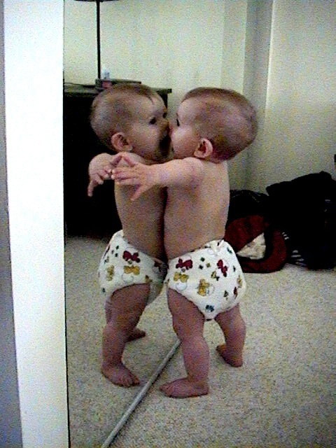
NUnit
Nunit
Version: 1.0
Author: Nguyen Quoc Su
Sunday, November 8, 2026
Instructor: Nguyen Quoc Su
DL P1.D2

Slide 2

Introduction
Duration: 2 hours
Purpose: Understand about NUnit test tool
Audience: Coder
Test: Coding test case by Nunit tool

Slide 3

Objective
After the course, student will:
Understand about NUnit test tool
Create a test case by NUnit

Slide 4

Contents
Why UNit test?
When to do Unit test?
What is NUnit?
Where to get NUnit tool?
How to use NUnit?
Demo
5W&H
Don’t ask me…

Slide 5

Murphy's Law
Anything that can go wrong will go wrong

Slide 6

Why Unit Test?
What is Unit Test
  Unit test is testing an individual hardware or software unit
What are the purpose of Unit Test
  Increase the quality of the product
  Reduce maintenance effort
  Find bug early
  Reduce costs
How to do Unit test
  By manual
  By test tool
Why I need to test my perfect code?

Slide 7
When to do Unit test?
Basic Coding Process
Analyse
Requirement
Write down
Code skeleton
Write Unit
Test Case
Analyse
Test Repot
Run Unit Test
Do Coding

Slide 8

What is NUnit?
Milk ? Beer or Coffee?
NUnit – an open source test tool for .NET
Useful for development and regression
Leads to a design-for-test approach
Tests can be written in VB.NET or C#

Slide 9

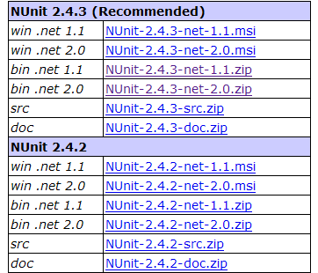
Where to get Nunit?
Download
Let’s go to website: http://www.nunit.org/index.php?p=download
Yeahh, I got it

Slide 10
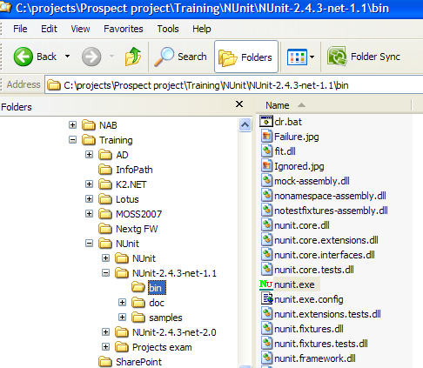

Where to get Nunit?
Extract to any folder
mumm, it is easy

Slide 11
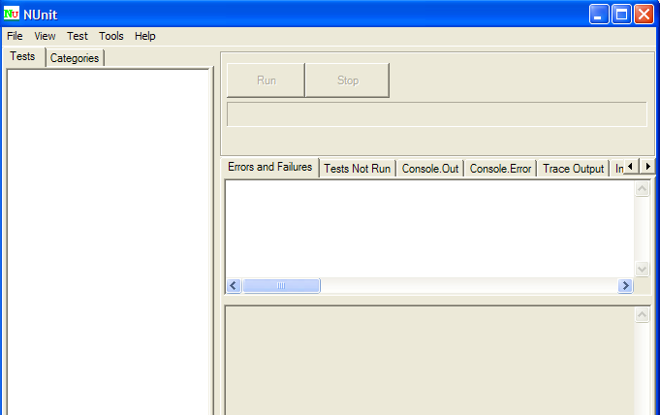

Where to get Nunit?
Screen of tool
Yeahh, It tastes good

Slide 12

How to use NUnit?
Create a test case base on NUnit framework
Deploy and Run
Who knows…

Slide 13

How to use NUnit?
Create a test case
Step 1: Create a Class
Step 2: Add a reference nunit.Framework.dll to this class
Step 3: Add a reference to *.dll contains function which you want to do Unit test
Step 4: Restructure class following Nunit frame work
Step 5: Write a test case
Let’s me go…

Slide 14
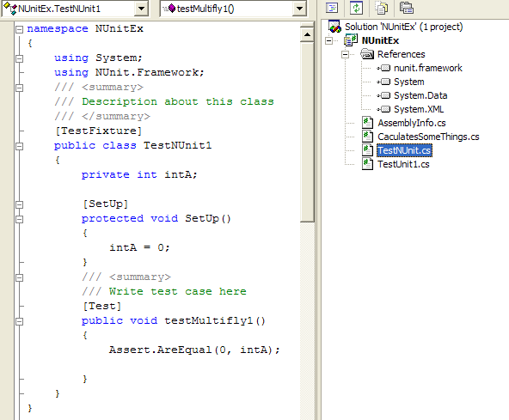
How to use NUnit?
Create a test case
Step 1: Create a Class
Step 2: Add a reference nunit.Framework.dll to this class
Step 3: Add a reference to *.dll contains function which you want to do Unit test
Step 4: Restructure class following Nunit frame work

Slide 15

How to use NUnit?
Create a test case
Step 5: Write a test case
  Each test case will be a function/method of class
  Must have attribute [Test] above a function/method
  Ex:
    [Test]
public void testCase1()
{
Assert.AreEqual(0, intA);
}
    [Test]
public void testCase2()
{
Assert.AreEqual(0, divides(intA, intB));
}
Beer Please !!!

Slide 16
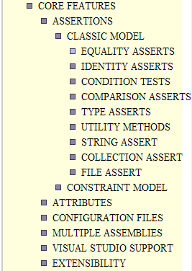
How to use NUnit?
Core Features
Core Features to code a test case
  Assertions
    Equality Assserts:
      Ex: Assert.AreEqual( int expected, int actual );
    Condition Tests:
      Ex: Assert.IsTrue( bool condition );
    Comparrison Asserts
      Ex: Assert.Greater( int arg1, int arg2 );
    Type Asserts
      Ex: Assert.IsInstanceOfType( Type expected, object actual );
    Utility methods
      Ex: Assert.Fail();
    String Assert
      Ex: StringAssert.Contains( string expected, string actual );
    Collection Asserts
      Ex: CollectionAssert.AreEqual( Collection expected, Collection actual );
  Attributes

Slide 17
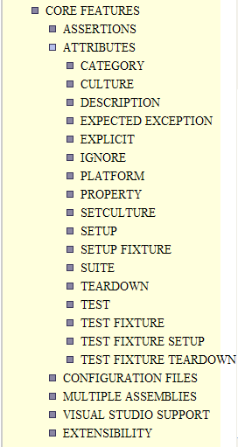
How to use NUnit?
Core Features
  Attributes
    [TestFixture]
    [Category("TestUnitExample")]
    public class TestNUnit
    {
    private int intA;
    private int intB;
    private CaculatesSomeThings objCal;
    [SetUp]
    protected void SetUp()
    {
    intA = 0;
    intB = 0;
    objCal = new CaculatesSomeThings();
    }
    [Test]
    Public void TestCase1()
    {
    Assert.AreEqual(0, objCal.Multifly(intA, intB))
    }

Slide 18

How to use NUnit?
Deploy and Run
Step 1: Compile a test case class to dll
Step 2: Run NUnit tool
Step 3: Open *.dll contains test case class
Step 4: Choose the test case you want to run
Step 5: Click run button to see the report
I don’t believe…

Slide 19
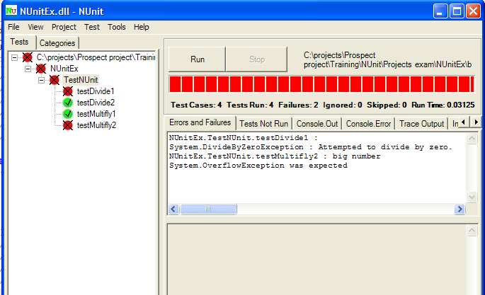

How to use NUnit?
Deploy and Run
Quality… God let me sleep

Slide 20

DEMO
DEMO
NUnit is
Number One.

Slide 21

CONCLUSION
Why UNit test
When to do Unit test
What is NUnit
Where to get NUnit tool
How to use NUnit

Slide 22
Resource and Reference
Resources and Reference
  http://www.nunit.org/index.php?p=docHome&r=2.4.3

Slide 23

5W&H
Questions and Answers

